Slide 1




GhanaPay
–
“Fintech Company"

Slide 2

AGENDA
ANALYTICAL TEAM
PROJECT PROBLEM
PROCESS
INSIGHTS
RECOMMENDATIONS
SUMMARY
DATA ANALYTS
Ohenenana Sintim Poku Annor
Rene Adu Missah
Kenneth Akonnor Hayford
Justina Arthur
Suzzy Lartey
Diana Graham Adusei Acquaah
Genevieve Naa Teteley Quarshie
Eunice Danso
Business Context
GhanaPay is a rapidly growing fintech company in Ghana, providing mobile money services, digital payments, and micro-lending solutions.
The Business Problem
•What key challenges or gaps could be affecting customer experience or business growth?
•What areas of the business (e.g., mobile money, micro-lending, payment volume) should be tracked to make better decisions?

Slide 3

Process
1
Data understanding
Data Cleaning
2
Data modeling
3
Data Analysis
4
5
Uncover Insights

Slide 4
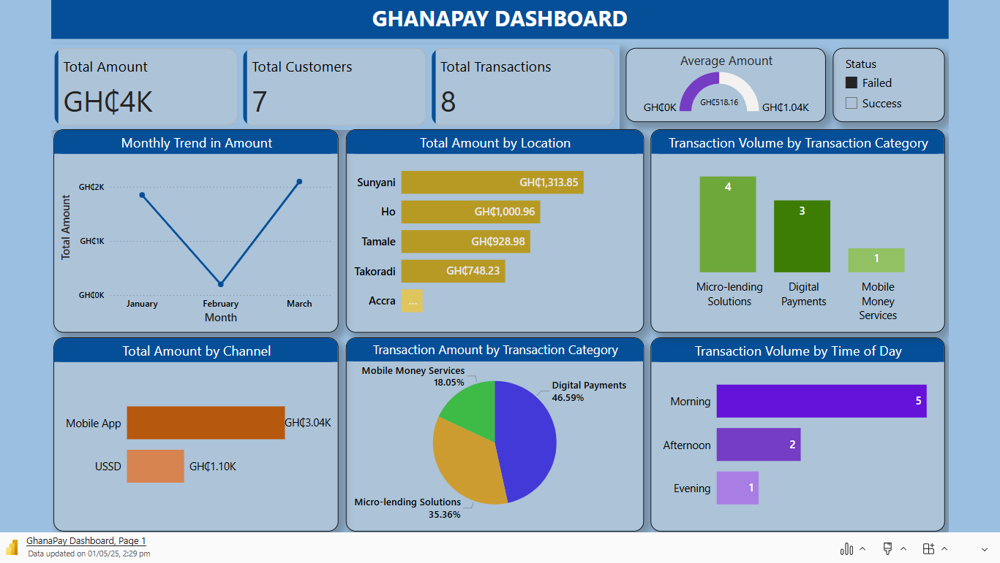

Slide 5
Service Category
Mobile Money Services – Mobile Money transfer
Digital Payments – Airtime Purchase, Bill Payments, Merchant Payment
Micro-lending Solutions – Loan Repayment, Loan Disbursement
Channel
Mobile App – Android , IOS
USSD - USSD
Insights
The analysis revealed there is an 8% transaction failure rate and this could pose a risk to customer experience.
Transaction volume and value are very low in Accra, this could indicate untapped growth potential.
Transaction volume steadily increased from GHS15,547.81 in January to a peak of GHS18,217.96 in March. However, in April, it dropped sharply to GHS833.24 — a significant decrease of about 95.4% compared to March

Slide 6
Insights
Number of transaction is at its highest in the Morning and had the highest failed transactions compared to Afternoon and Evening session.
Mobile app had the highest number of transaction and volume compared to USSD. Mobile App Generates 73% of transaction value vs. USSD (27%).
Digital Payments and Micro-lending solutions account for 80% of Ghana Pay's transaction volume, indicating they are the company’s core drivers. It is therefore recommended that strategic efforts and resources be focused on enhancing and expanding these services

Slide 7
Recommendations
Investigate why users aren’t transacting(April) repeatedly and target re-engagement campaigns for inactive users (e.g., SMS/email reminders, loyalty rewards).
Explore Accra’s underperformance—competition, poor marketing, or infrastructure gaps. Prioritize localized campaigns (e.g., partnerships with local businesses).
Focus on app improvement (e.g., UX/UI, stability).
Conclusion
Transaction volumes peaked in March but dropped sharply in April, highlighting the need for user re-engagement. Accra shows untapped potential despite being the capital. Mobile App dominates usage, while Digital Payments and Micro-lending drive most transactions. Addressing the 8% failure rate and improving peak-time performance are key to enhancing user experience and growth.

Slide 8

Thank you!
ANY QUESTIONS?

